Slide 1
CDBG – How to Choose Your Projects
Moderator: Angela Rahman, Community Development Manager
City of Kettering, OH

Slide 2
Speakers
Michelle Guzman
Senior Project Manager
City of Riverside, CA
Heather Johnson
Community Development Resources Manager
City of Davenport, IA
mesbjerg@pascocountyfl.net
heather.johnson@davenportiowa.com

Slide 3
CDBG- How to Choose Your Projects
Using Data to Prioritize Greatest Needs

Slide 4
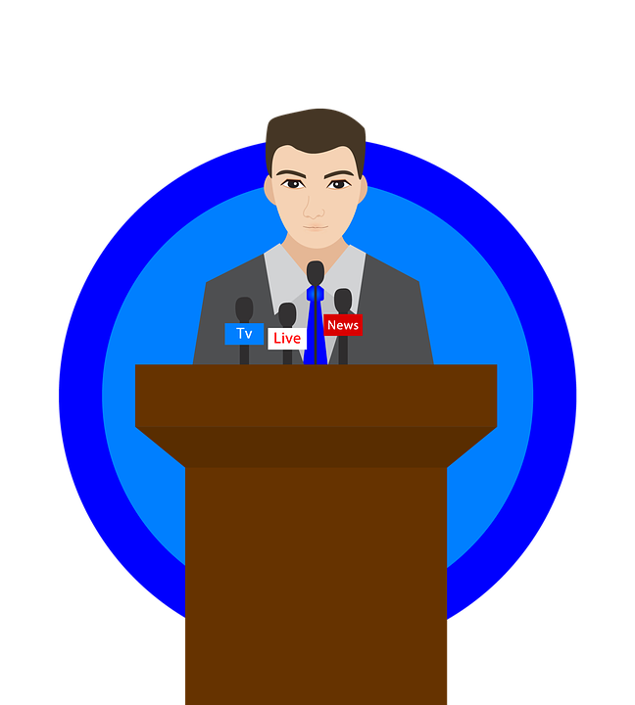
CDBG- How to Choose Your Projects
Political Input

Slide 5
CDBG- How to Choose Your Projects
Community Input – ideal
Community Input – not ideal

Slide 6
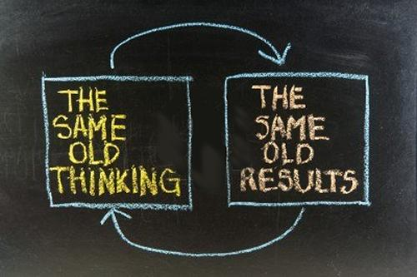
CDBG- How to Choose Your Projects
What We’ve Always Done

